Slide 1
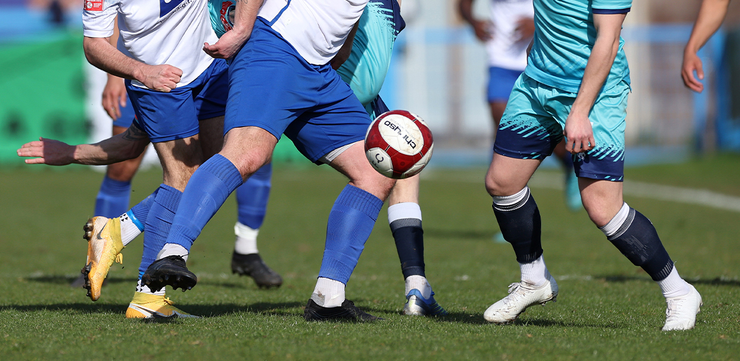
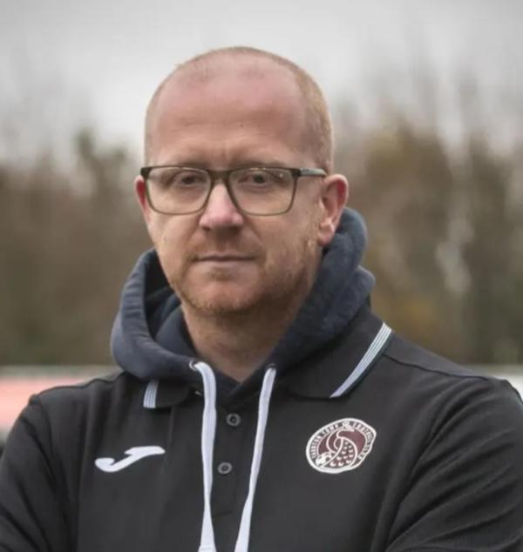
James Blackmore
Club Welfare Officer (CWO)
01823 254909 (Club)
welfareofficer@tauntontown.com

